Slide 1
Welcome to the lecture
We’ll be starting shortly

Slide 2
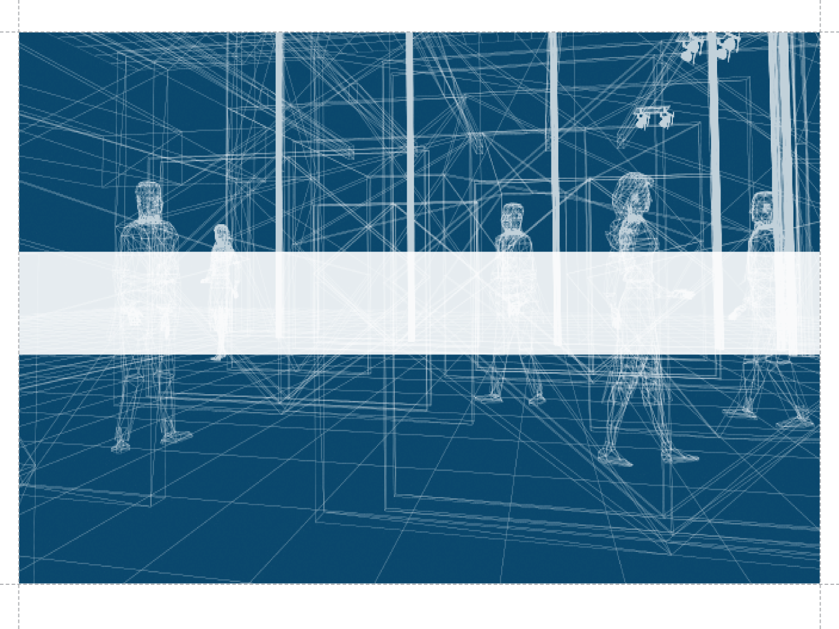
Fusion 360 Session Two: Constraints, Bodies and Components
Presenter: Thayne Wickam Q & A: Harpreet Waraich

Slide 3
Instructor Bio
Thayne Wickam
IMAGINiT Technologies in New Hampshire
Automation industry from 1986-1994
Used Autodesk products since 1986
Autodesk and/ or resellers since 1994
Involved with Implementation and Training
Autodesk support world-wide from 2004-2010
For AutoCAD Electrical
Notes:
Instructor Bio:
Thayne Wickam
IMAGINiT Technologies in New Hampshire
Automation industry from 1986-1994
Used Autodesk products since 1986
Autodesk and/ or resellers since 1994
Involved with Implementation and Training
Autodesk support world-wide from 2004-2010, for AutoCAD Electrical

Slide 4
Services
https://www.imaginit.com/about/overview
Notes:
IMAGINiT Technologies is a division of Rand Worldwide and advances the way architects and engineers use 3D technology to design, develop, and manage complex engineering projects.
Customers include organizations in the building, infrastructure, manufacturing and facilities management industries looking to gain competitive advantages through technology, professional services, training, and support.

Slide 5
Agenda
Add Components to a Design
Convert Secondary Features to a New Body
Create Multiple Bodies
Move and Align Bodies
Create Components from Bodies
Notes:
Today we will be covering:
Add Components to a Design
Convert Secondary Features to a New Body
Create Multiple Bodies
Move and Align Bodies
Create Components from Bodies

Slide 6
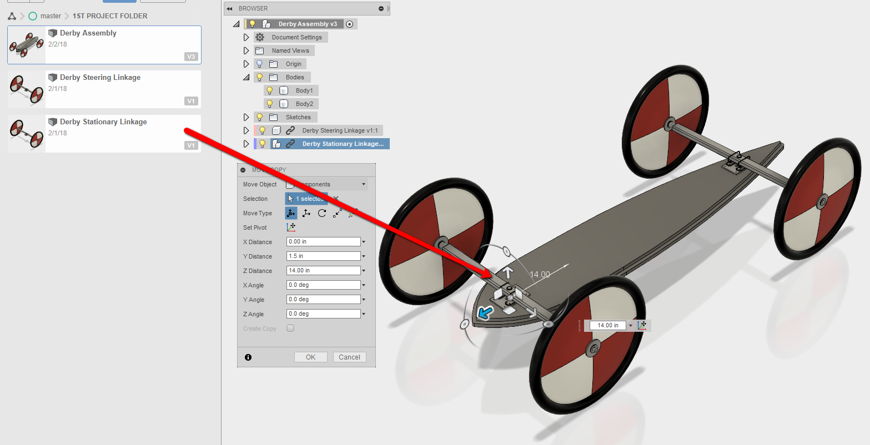
Add Components to a Design
How to add existing components to a design:
Once components or assemblies have been created and saved they can be added to a design.
Notes:
From our last session, we brought in the steering and stationary linkage.
Then we saved the designs in our project folder
In this session we are going to place them in the design we created from scratch for the floorboard

Slide 7
Add Components to a Design
Exercise One: Add the Steering and Stationary Linkage
Open the Derby Assembly file
Drag and drop both stationary and steering linkages into the design
Raise both up 1.5 in the Y direction (Up/ Down)
Move the steering linkage to 47 inches in the Z direction (Forward/ Back)
Move the stationary linkage -14 inches in the Z direction (Forward/ Back)
Notes:
Do the following steps:
Open the Derby Assembly file
Drag and drop both stationary and steering linkages into the design
Raise both up 1.5 in the Y direction (Up/ Down)
Move the steering linkage to 47 inches in the Z direction (Forward/ Back)
Move the stationary linkage -14 inches in the Z direction (Forward/ Back)

Slide 8
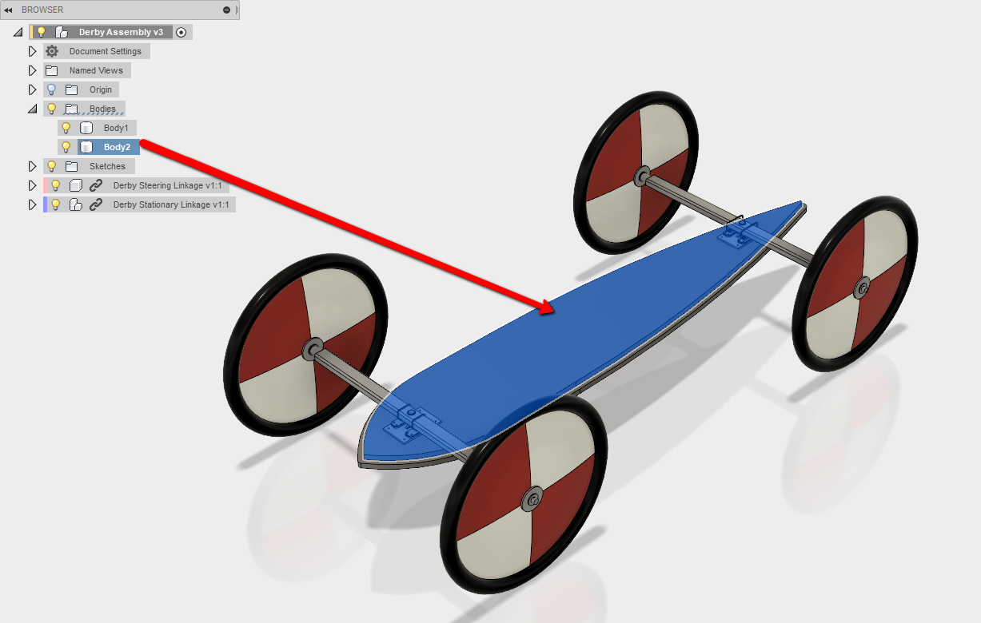
Convert Secondary Features to a New Body
Existing bodies can be converted into components:
Once a body has been designed to be a body, it can be converted into a component
Notes:
We had done a second extrude at the end of the last session.
In this session we will convert that extrusion into a second body.

Slide 9
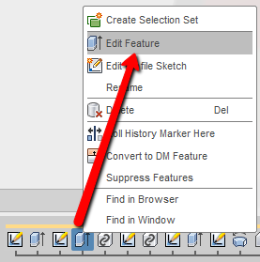
Convert Secondary Features to a New Body
Exercise Two: Convert a Feature to a New Body
Edit the second extrude feature.
Right Click on the second extrusion in the history, from the last session
Select Edit Feature, to modify the extrude for the top floorboard
Notes:
Right Click on the second extrusion in the history, from the last session
Select Edit Feature, to modify the extrude for the top floorboard

Slide 10
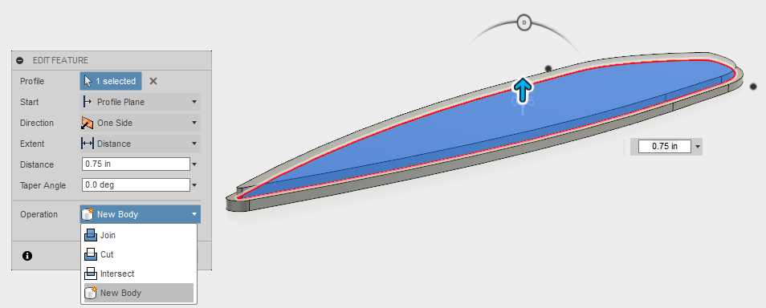
Convert Secondary Features to a New Body
Exercise Two: Convert a Feature to a New Body
Switch from new feature to new body.
Expand the Operations list
Select New Body
Notes:
Expand the Operations list
Select New Body

Slide 11
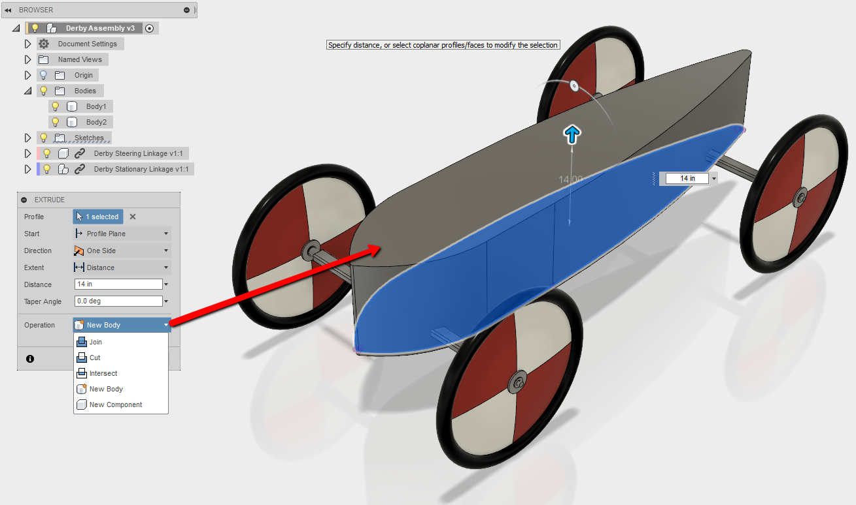
Create Multiple Bodies
Extrude a New Body
Extrusions, revolves etc. can be created as a separate body when creating the feature.
Notes:
You can create a new body when starting a feature, like extrude, revolve etc.
Just select New Body from the operations flyout.
The bodies being created will eventually be converted to components later.

Slide 12
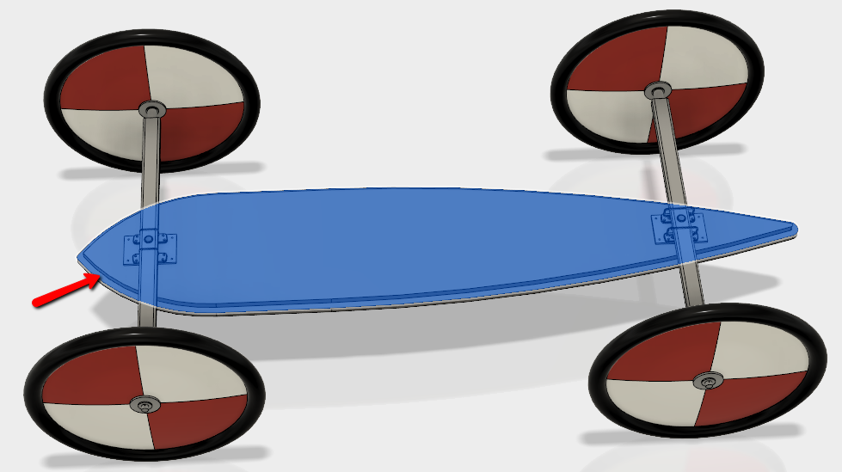
Create Multiple Bodies
Exercise Three: Extrude a New Body
Create a sketch to make the fuselage.
Create a new sketch
Select the top of the first extrusion as the plane/ face to use
Notes:
Create a new sketch
Select the top of the first extrusion as the plane/ face to use

Slide 13
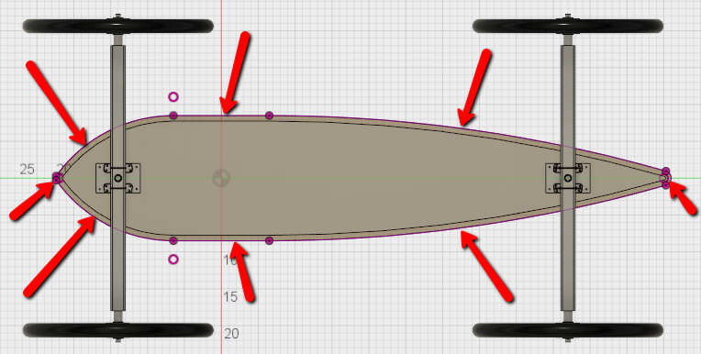
Create Multiple Bodies
Exercise Three: Extrude a New Body
Project the profile for the extrusion.
Select Sketch> Project/ Include> Project
Pick the outer perimeter edges, including the front and back small arcs
Notes:
Select Sketch> Project/ Include> Project
Pick the outer perimeter edges, including the front and back small arcs

Slide 14
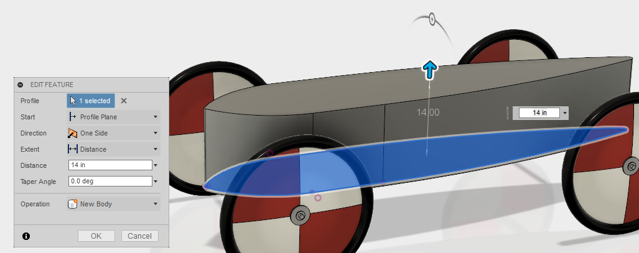
Create Multiple Bodies
Exercise Three: Extrude a New Body
Extrude the profile for the fuselage.
Extrude the outer profile that was create on the sketch 14 inches
Select New Body in the Operations flyout to make it a separate body
Notes:
Extrude the outer profile that was create on the sketch 14 inches
Select New Body in the Operations flyout to make it a separate body

Slide 15
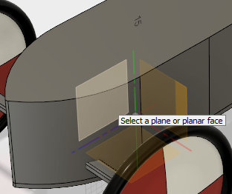
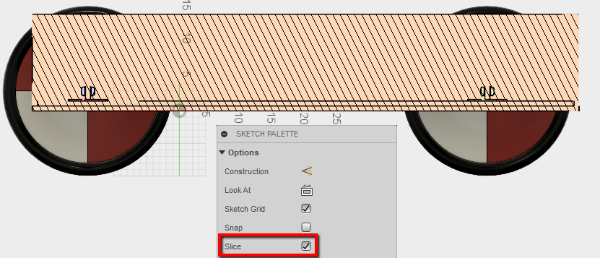
Create Multiple Bodies
Exercise Four: Revolve Cut a Contour
Create a contour profile for the fuselage.
Create a new sketch on the YZ origin plane
Turn on the slice graphics in the sketch palette
Notes:
Create a new sketch on the YZ origin plane
Turn on the slice graphics in the sketch palette

Slide 16
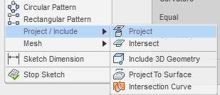
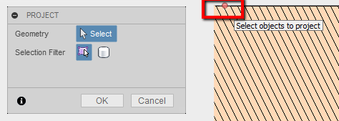
Create Multiple Bodies
Exercise Four: Revolve Cut a Contour
Project reference geometry for the contour profile.
Start the Project command again
Project the edge of the large arc on the right
Select the center point of the small arc on the left
Notes:
Start the Project command again
Project the edge of the large arc on the right
Select the center point of the small arc on the left

Slide 17
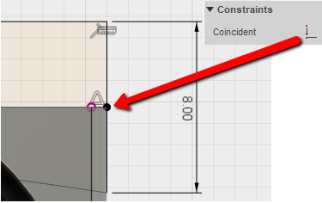
Create Multiple Bodies
Exercise Four: Revolve Cut a Contour
Constraints and dimensions for contour profile.
Create an 8 inch vertical line
Apply a coincident constraint to the midpoint of the vertical line and the right point of the far right projected line
Create the rest of the closed profile shown below
Notes:
Create an 8 inch vertical line
Apply a coincident constraint to the midpoint of the vertical line and the right point of the far right projected line
Create the rest of the closed profile shown below

Slide 18
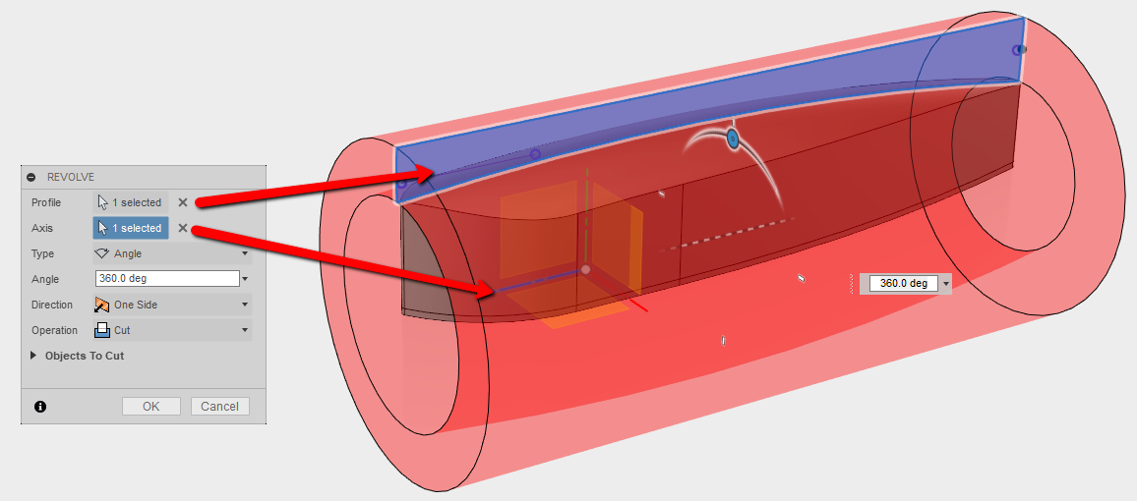
Create Multiple Bodies
Exercise Four: Revolve Cut a Contour
Create a revolve cut for the contour.
Do a revolve cut of the profile about the Z axis
Note: turning off the other bodies and components is optional for a better visual
Notes:
Do a revolve cut of the profile about the Z axis
Note: turning off the other bodies and components is optional for a better visual

Slide 19
Create Multiple Bodies
Exercise Five: Fillet the Contour
Fillet the top edge of the contour.
Add a 4 inch fillet to the top edge of the fuselage
Notes:
Add a 4 inch fillet to the top edge of the fuselage

Slide 20
Create Multiple Bodies
Exercise Six: Shell the Fuselage
Create a shell and remove the bottom face of the fuselage.
Turn off all bodies except for the fuselage
Rotate the view and shell the fuselage to a thickness of .75 inches
Removing the bottom face
Notes:
Turn off all bodies except for the fuselage
Rotate the view and shell the fuselage to a thickness of .75 inches
Removing the bottom face

Slide 21
Create Multiple Bodies
Exercise Seven: Create the Cockpit Opening
Create an offset plane for .
Create a new offset plane 15 inches from the XZ plane
Notes:
Create a new offset plane 15 inches from the XZ plane

Slide 22
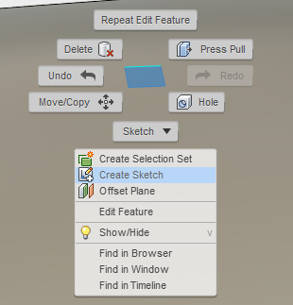
Create Multiple Bodies
Exercise Seven: Create the Cockpit Opening
Create a sketch for cockpit opening.
Create a new sketch on the offset plane
Notes:
Create a new sketch on the offset plane

Slide 23
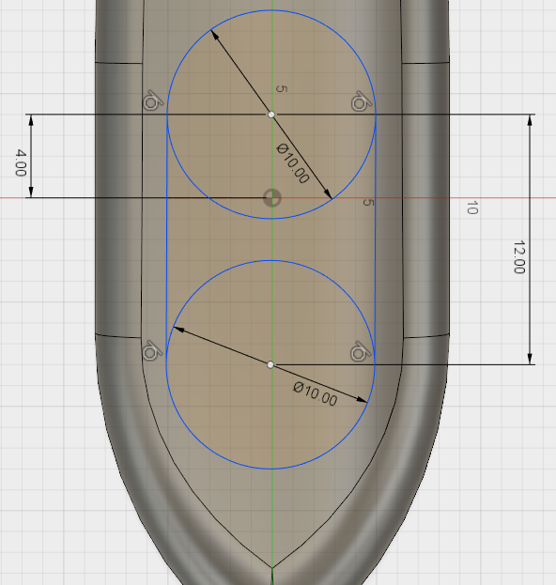
Create Multiple Bodies
Exercise Seven: Create the Cockpit Opening
Create the profile for cockpit opening.
Create two 10 inch circles
Vertically align the center of the circles to the origin center point
Create tangent lines on each sides of the circle
Dimension the front circle 4 inches from the center point
Dimension the both circle’s center points 12 inches apart
Notes:
Create two 10 inch circles
Vertically align the center of the circles to the origin center point
Create tangent lines on each sides of the circle
Dimension the front circle 4 inches from the center point
Dimension the both circle’s center points 12 inches apart

Slide 24
Create Multiple Bodies
Exercise Seven: Create the Cockpit Opening
Cut the opening for the cockpit.
Extrude and cut 4 inches into the fuselage
Notes:
Extrude and cut 4 inches into the fuselage

Slide 25
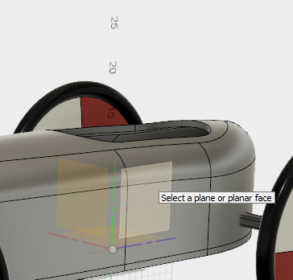
Create Multiple Bodies
Exercise Eight: Create the Steering Linkage Opening
Create steering cutout opening.
Create a new sketch on the YZ origin plane
Notes:
Create a new sketch on the YZ origin plane

Slide 26
Create Multiple Bodies
Exercise Eight: Create the Steering Linkage Opening
Create the cutout profile.
Create a new sketch on the YZ origin plane
Activate the slice graphics in the sketch pallet
Create a 10 X 3 inch rectangle at the front of the fuselage
Constraint the middle of the rectangle to the midpoint of the base of the steering linkage
Notes:
Create a new sketch on the YZ origin plane
Activate the slice graphics in the sketch pallet
Create a 10 X 3 inch rectangle at the front of the fuselage
Constraint the middle of the rectangle to the midpoint of the base of the steering linkage

Slide 27
Create Multiple Bodies
Exercise Eight: Create the Steering Linkage Opening
Extrusions, revolves etc. can be created as a separate body when creating the feature.
Turn off all bodies and components, except for the fuselage body
Extrude cut the profile through the fuselage symmetrically
Notes:
Turn off all bodies and components, except for the fuselage body
Extrude cut the profile through the fuselage symmetrically

Slide 28
Create Multiple Bodies
Exercise Nine: Creating a Foot Stop
Create the foot stop on the top floorboard.
Turn off the fuselage body
Create a new sketch on the top floorboard
Notes:
Turn off the fuselage body
Create a new sketch on the top floorboard

Slide 29
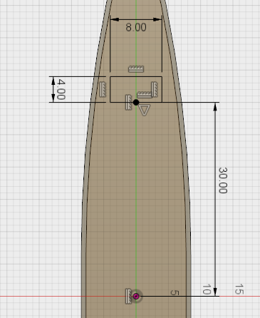
Create Multiple Bodies
Exercise Nine: Creating a Foot Stop
Extrusions, revolves etc. can be created as a separate body when creating the feature.
Create an 8 X 4 rectangle towards the front of the floorboard
Vertically constraint the midpoint of the rectangle and the center point of the design
Dimension the bottom of the rectangle to the center point of the design
Notes:
Create an 8 X 4 rectangle towards the front of the floorboard
Vertically constraint the midpoint of the rectangle and the center point of the design
Dimension the bottom of the rectangle to the center point of the design

Slide 30
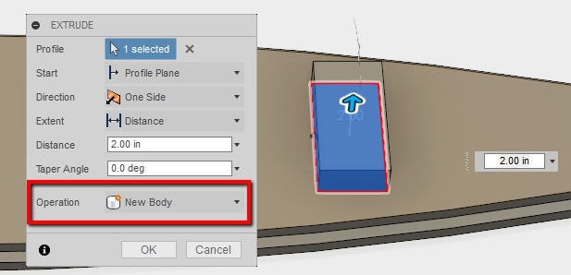
Create Multiple Bodies
Exercise Nine: Creating a Foot Stop
Extrude the foot stop profile.
Extrude the profile 2 inches
Select New Body in the operations flyout
Notes:
Extrude the profile 2 inches
Select New Body in the operations flyout

Slide 31
Move and Align Bodies
How to move/ rotate bodies and align them:
Bodies can be moved, rotated and aligned to other.
Notes:
Bodies can be moved or rotated after being created.
This will give you three Transitional and three rotational options in the triad.
The orientation of the triad can be world, local or by the view.
Values can also be typed in for precision.

Slide 32
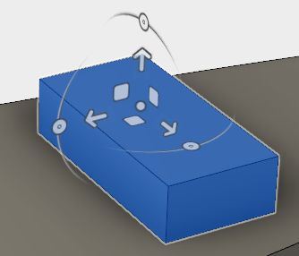
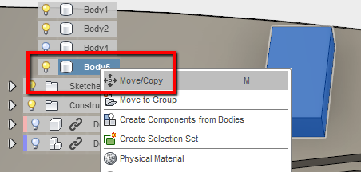
Move and Align Bodies
How to move/ rotate bodies and align them:
Bodies can be moved, rotated using a triad with precision. The transform then can be captured on the timeline.
Notes:
The easiest way to move or rotate an body is to right click on it in the browser and select Move/ Copy.
This will create the triad on the body for the transformation.

Slide 33
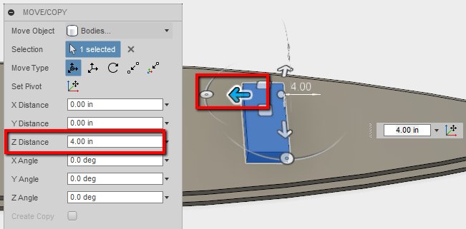
Move and Align Bodies
Exercise Ten: Moving the Foot Stop
Bodies can be aligned to other bodies with precision. The transform then can be captured on the timeline.
Right click on the newly extruded body for the foot stop
Select Move/ Copy
Move the foot stop body 4 inches in the Z direction
Notes:
Right click on the newly extruded body for the foot stop
Select Move/ Copy
Move the foot stop body 4 inches in the Z direction

Slide 34
Create Components from Bodies
Convert existing bodies into components:
Save bodies as components in the design file.
Notes:
Bodies can be converted into components so they can be saved as components for other designs.
Once the body is converted into a component, the sketch constraints no longer apply to the component.

Slide 35
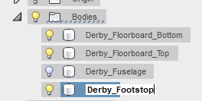
Create Components from Bodies
Exercise Eleven: Convert Bodies to Components
Save bodies as components from the design file.
Slowly pick twice on each of the bodies to rename them:
Derby_Floorboard_Bottom
Derby Floorboard_Top
Derby_Fuselage
Derby_Footsteps
Select all four bodies using the Shift key
Right click and select Create Bodies from Components
Notes:
Slowly pick twice on each of the bodies to rename them:
Derby_Floorboard_Bottom
Derby Floorboard_Top
Derby_Fuselage
Derby_Footsteps
Select all four bodies using the Shift key
Right click and select Create Bodies from Components

Slide 36
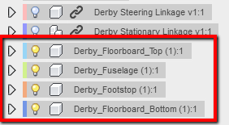
Create Components from Bodies
Exercise Eleven: Convert Bodies to Components
Save bodies as components from the design file.
The bowser should now show the bodies as components in the design
Notes:
The bowser should now show the bodies as components in the design

Slide 37
Questions?
We are happy to answer any questions you may have.
Contact Info:
info@rand.com
Technical Support: 888-528-4765
Phone: 800-356-9050
imaginit.com
Notes:
This will conclude this session. The next session will explain the difference of bodies and components. We will also continue with adding the fuselage body and the wheel linkage to the floorboard.
Looking forward to seeing you next session.

Slide 38
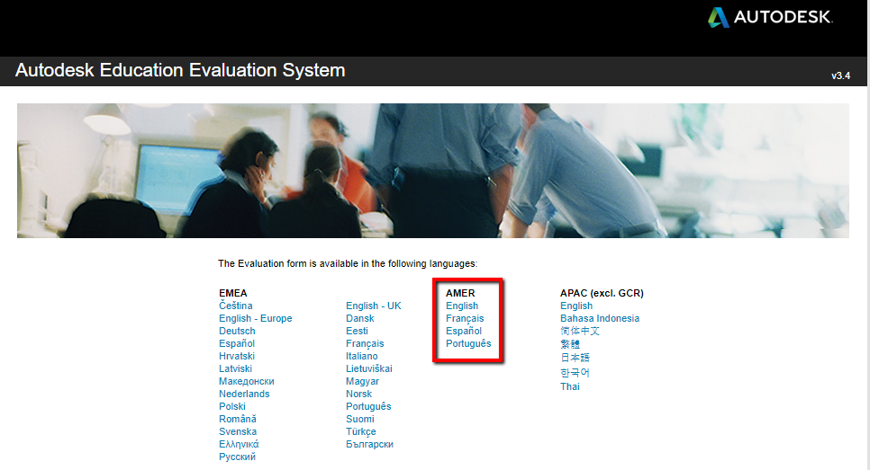
Receive Your Autodesk Course Completion Certificate
Log into https://eduevaluation.autodesk.com/
Notes:
For those that attended, here is the URL for your “Autodesk Course Completion Certificate”
Log into https://eduevaluation.autodesk.com/
Select the language you prefer under “AMER”

Slide 39
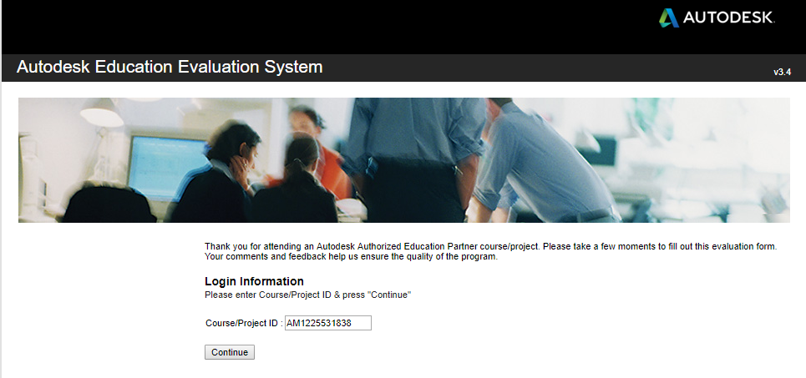
Receive Your Autodesk Course Completion certificate
Type in Course/ Project ID: AM1225531838
Notes:
Type in the Course/ Project ID, AM1225531838.
Fill out the form to register for completion.

Slide 40
Thanks!

