Slide 2
Fusion 360 Train-the-Trainer
Part 4

Slide 3
Assemblies
Two Techniques
Model all parts assembled in one Fusion 360 file
Top Down
Model separate parts in separate Fusion 360 files, and assemble them in another file
Bottom Up
When using Bottom Up technique, Joints will be defined to show how two parts connect
Different types of Joints will eliminate certain degrees of freedom

Slide 4
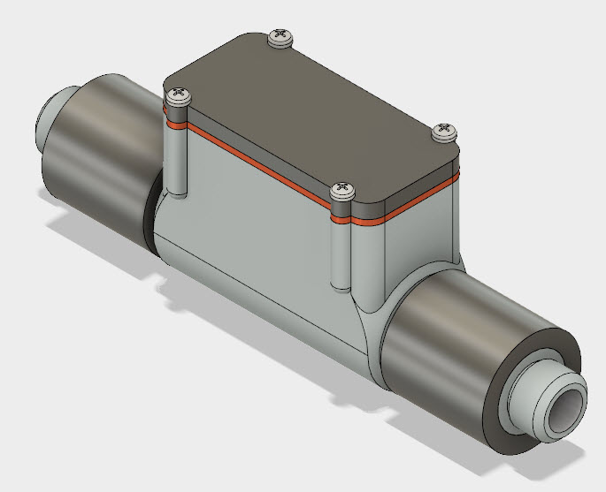
Design Challenge
File: New Fusion Model
Can you combine existing parts to start an assembly?
Can you model additional parts to properly represent the assembly?
https://youtu.be/JcUyR_4Texo

Slide 5
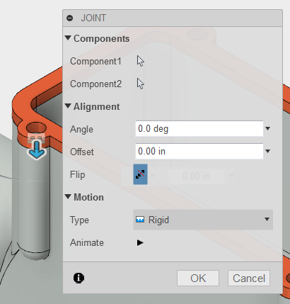
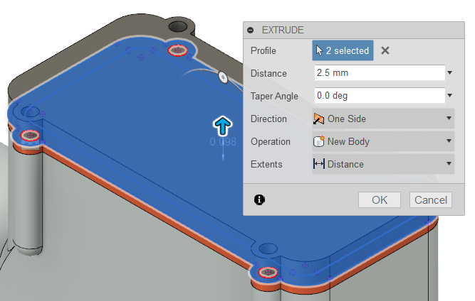
Activity
Place ACME-Res-Housing
Place ACME-Adaptive-Gasket
Create a Rigid Joint between the housing and gasket
Add a Component, name it Cap
Sketch the Cap on the top surface of the gasket
Extrude the Cap 2.5 mm

Slide 6
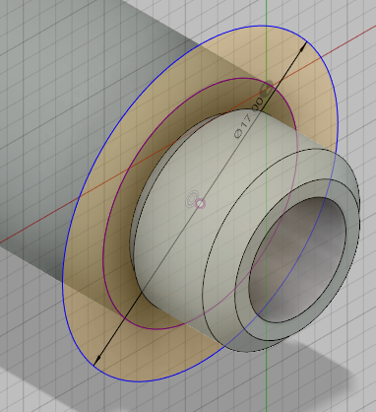
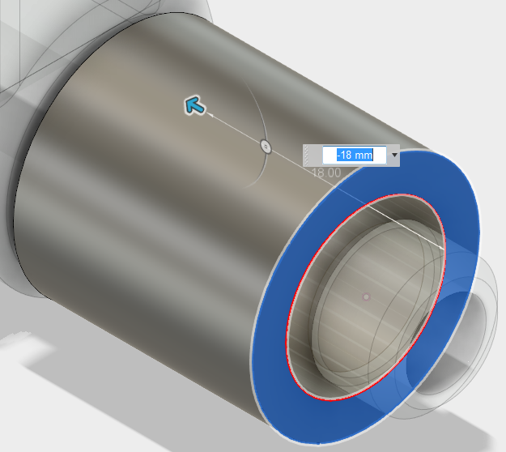
Activity
Create a new component named Collar
Create the sketch shown, the diameter of the outer circle is 17 mm
Extrude the shape 18 mm
Save Component as Collar
Place another occurrence of Collar
Create a Rigid Joint between the second collar and housing

Slide 7
Activity
Place 4 Recessed Pan Head Screws
Create Rigid Joints between the screws and the cap

Slide 8
Congratulations
You combined existing parts to start an assembly.
You modeled additional parts to properly represent the assembly.

Slide 9
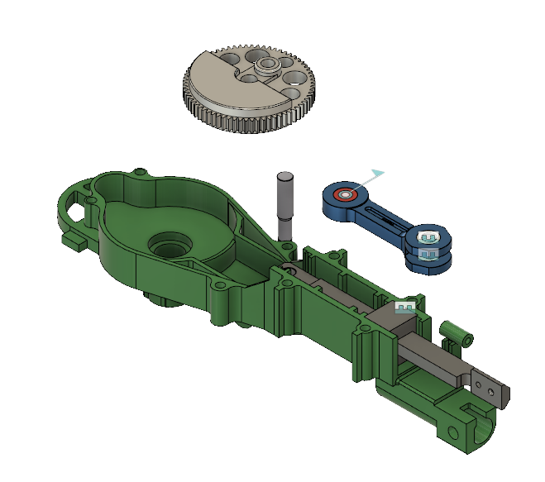
Class Exercise
File: New Fusion Model
Can you combine existing parts to make an assembly?
Can you use a Motion Study to see the motion of the assembly?
https://youtu.be/FAZEQv6aDt8

Slide 10
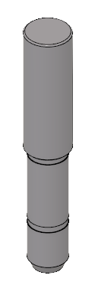
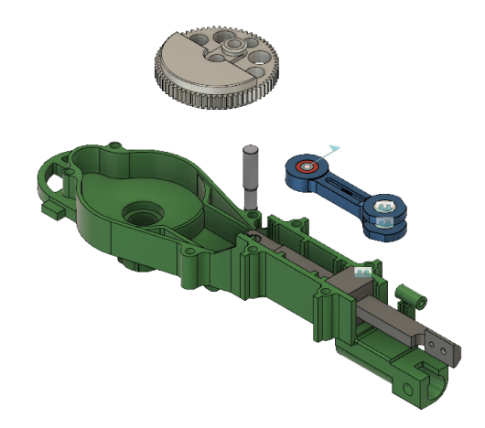
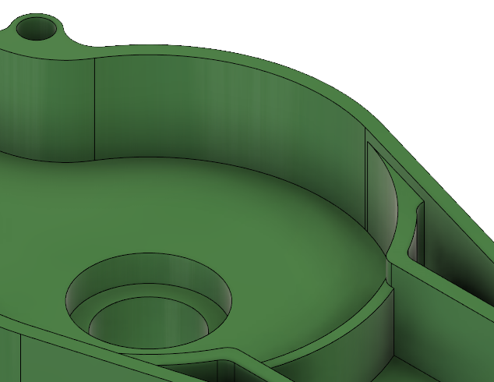
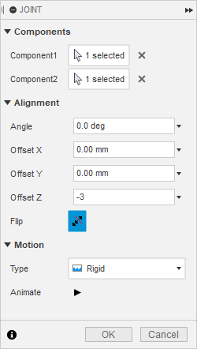
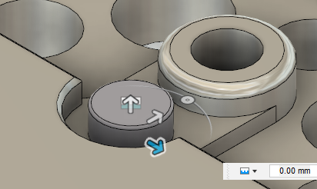
Activity
Download Assembly Joints.f3d
Use New Design From File and Assembly Joints.f3d to begin a new design
Create a Revolute Joint between the Pin and the Housing
Add a Rigid Joint between the Pin and Gear, use a 3 mm Offset

Slide 11
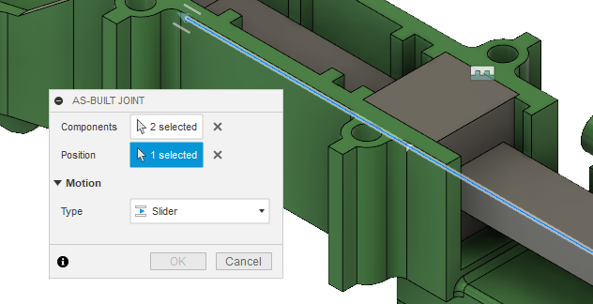
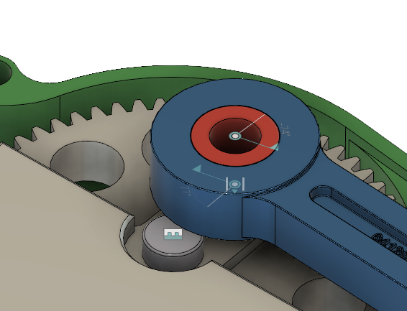
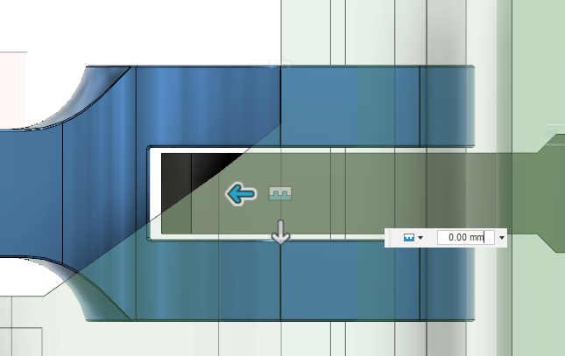
Activity
Create an As Built Joint between the Block Guide and the Connector Rod, using a Slider type
Create at Revolute Joint between the Crank Arm and the Connector Rod, use Between Two Faces to help
Create a Cylindrical Joint between the Crank Arm and Gear

Slide 12
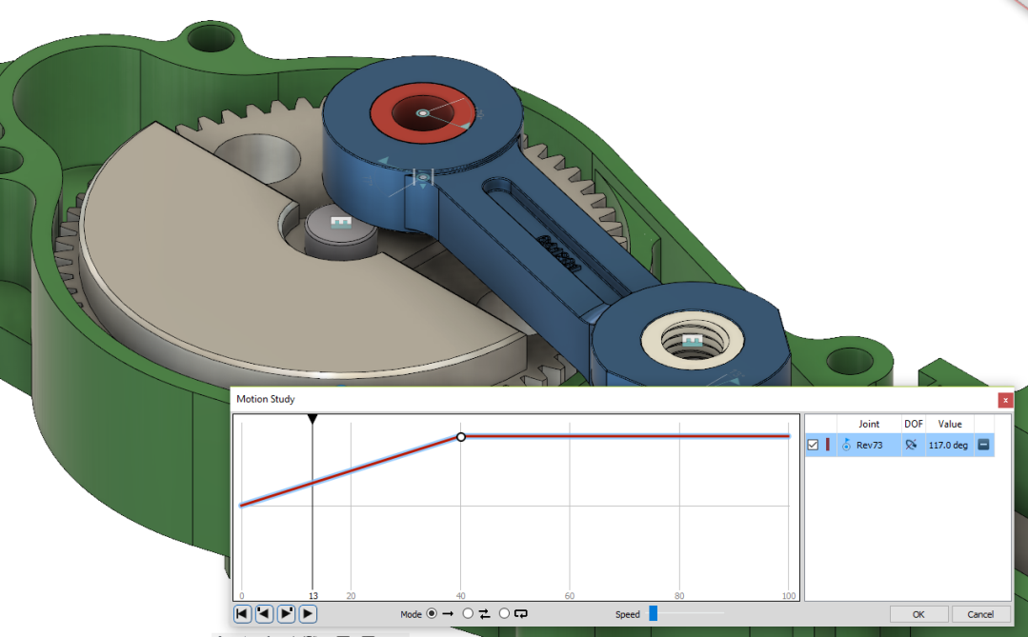
Activity
Animate the model, using the initial Revolute Joint
Drive the joint to set the angle back to 0 deg
Create a Motion Study to show the assembly motion

Slide 13
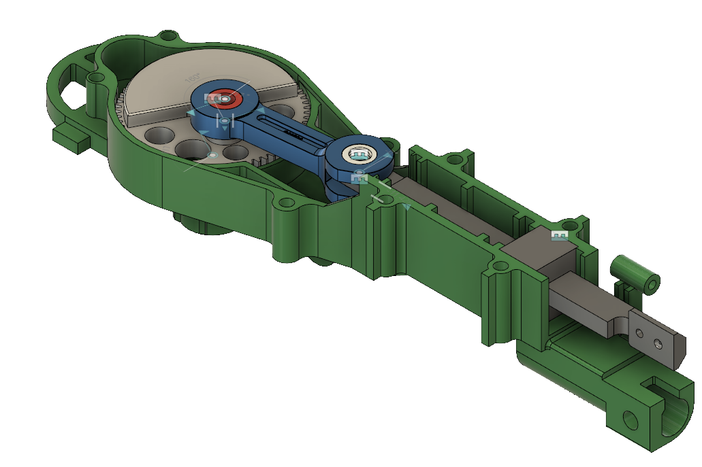
Congratulations
You combined existing parts to make an assembly.
You used a Motion Study to see the motion of the assembly.

Slide 14
Complete a short evaluation to get a FREE Gift Certificate and a chance to win a notebook.
If you have not already so, please go to this website to set up an Autodesk profile for course evaluations: http://education.autodesk.com/register.
Click the verification link in the email from Autodesk to verify and return to your account. From the left navigation bar, select “Search Course” and enter AM1018310968973 and register/enroll.
After the course, you can log into http://education.autodesk.com/login-student and complete the short evaluation by clicking the link located on the right side of the course details.
This is also the place where you can always print out your course completion.
Go to http://thinkedu.com/evaluation for more detailed information.

